Slide 1
P5 NPOI Concept Generation & Evaluation
Team Members:
Bradley Kingsley
Dustin Haines
Trung Son Nguyen

Slide 2
Naval precision Optical Interferometer
Main Purpose of NPOI:
Astronomical observation and a better understanding of how the universe works
Optical Interferometry:
Multiple telescopes collect light to be sent to the lab
The lab uses a beam combiner to create a synthesized data point

Slide 3
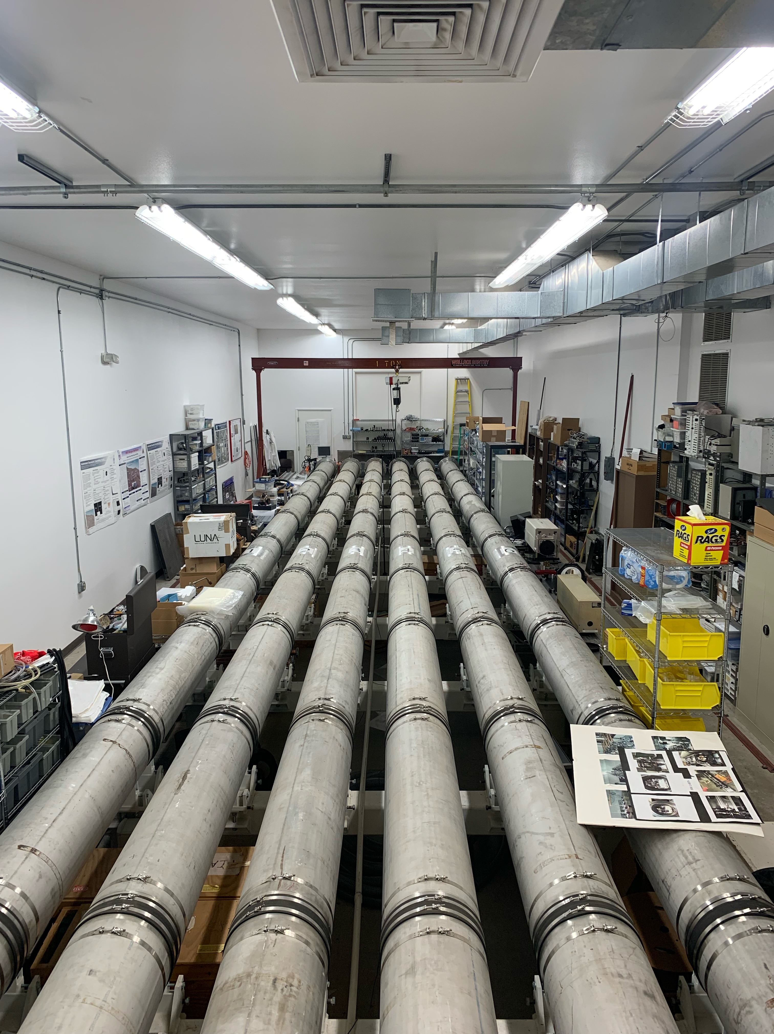
NPOI Project Description Review
Our Project: Designing seal plates for both ends of the Fast Delay Lines (FDL's) that are light and easy to remove, along with snoot layout optimization
It took three of us 5 hours to disassemble and reassemble 1 front of tank, no maintenance

Slide 4
Black Box Model
Notes:
Balck box model shows input and output of the seal plate. Inputting into the seal plate is stellar/metrology beams, external ATM pressure, and that the plate must be light weight. Outputting from the black box is stellar/metrology light, stress/deflection of the plate under Pressure, and easily removable is the output of lightweight.

Slide 5
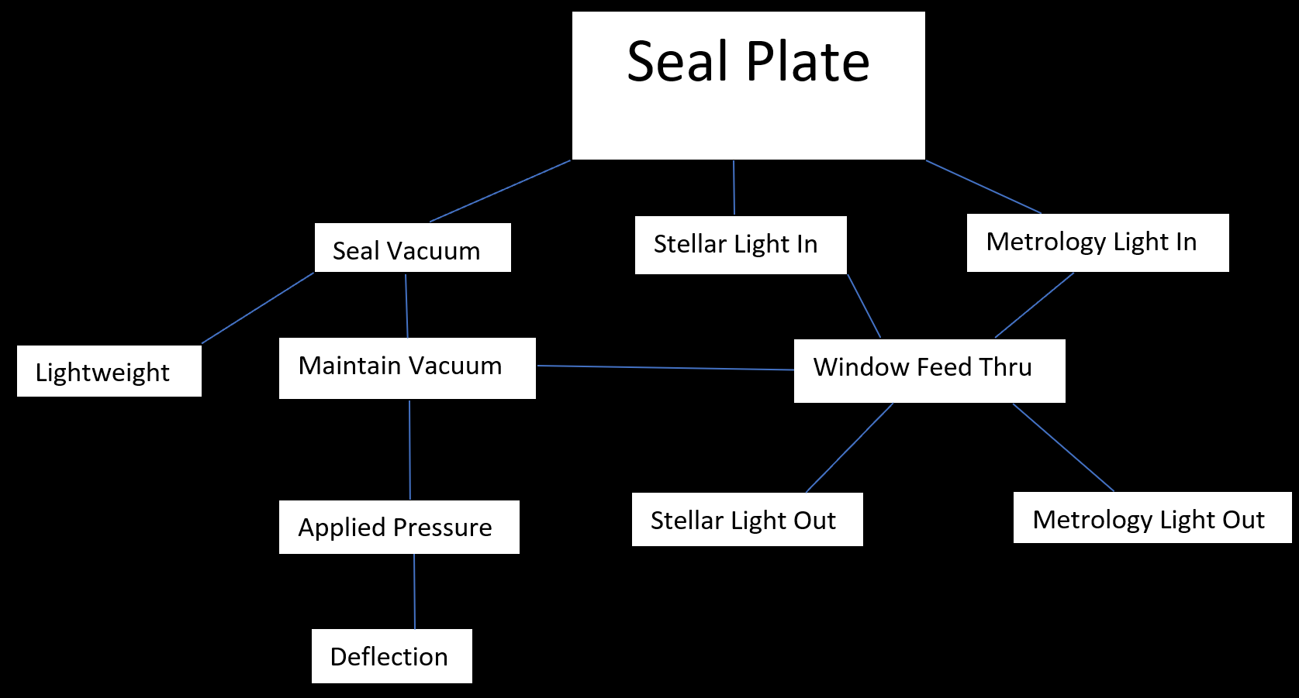
Decomposition Model
Notes:
The decomposition model shows how the seal plate seals to vacuum being the overarching goal, sealing to vacuum and light in are the main features. Withing those come the underlying points that affect the above sections. Such as the plate must seal to vacuum, meaning the vacuum must be maintained under applied pressure while deflected, along with being lightweight for handling purposes. Light in meaning the feed light has to enter the plate in some fashion, typically a vacuum feed thru window, then the light needs to be let out. This helped concept generation because it gave clear directions as to what has to be done and the key points of the project. Ensuring the concepts generated are maintaining refrence to the overarching goal.

Slide 6
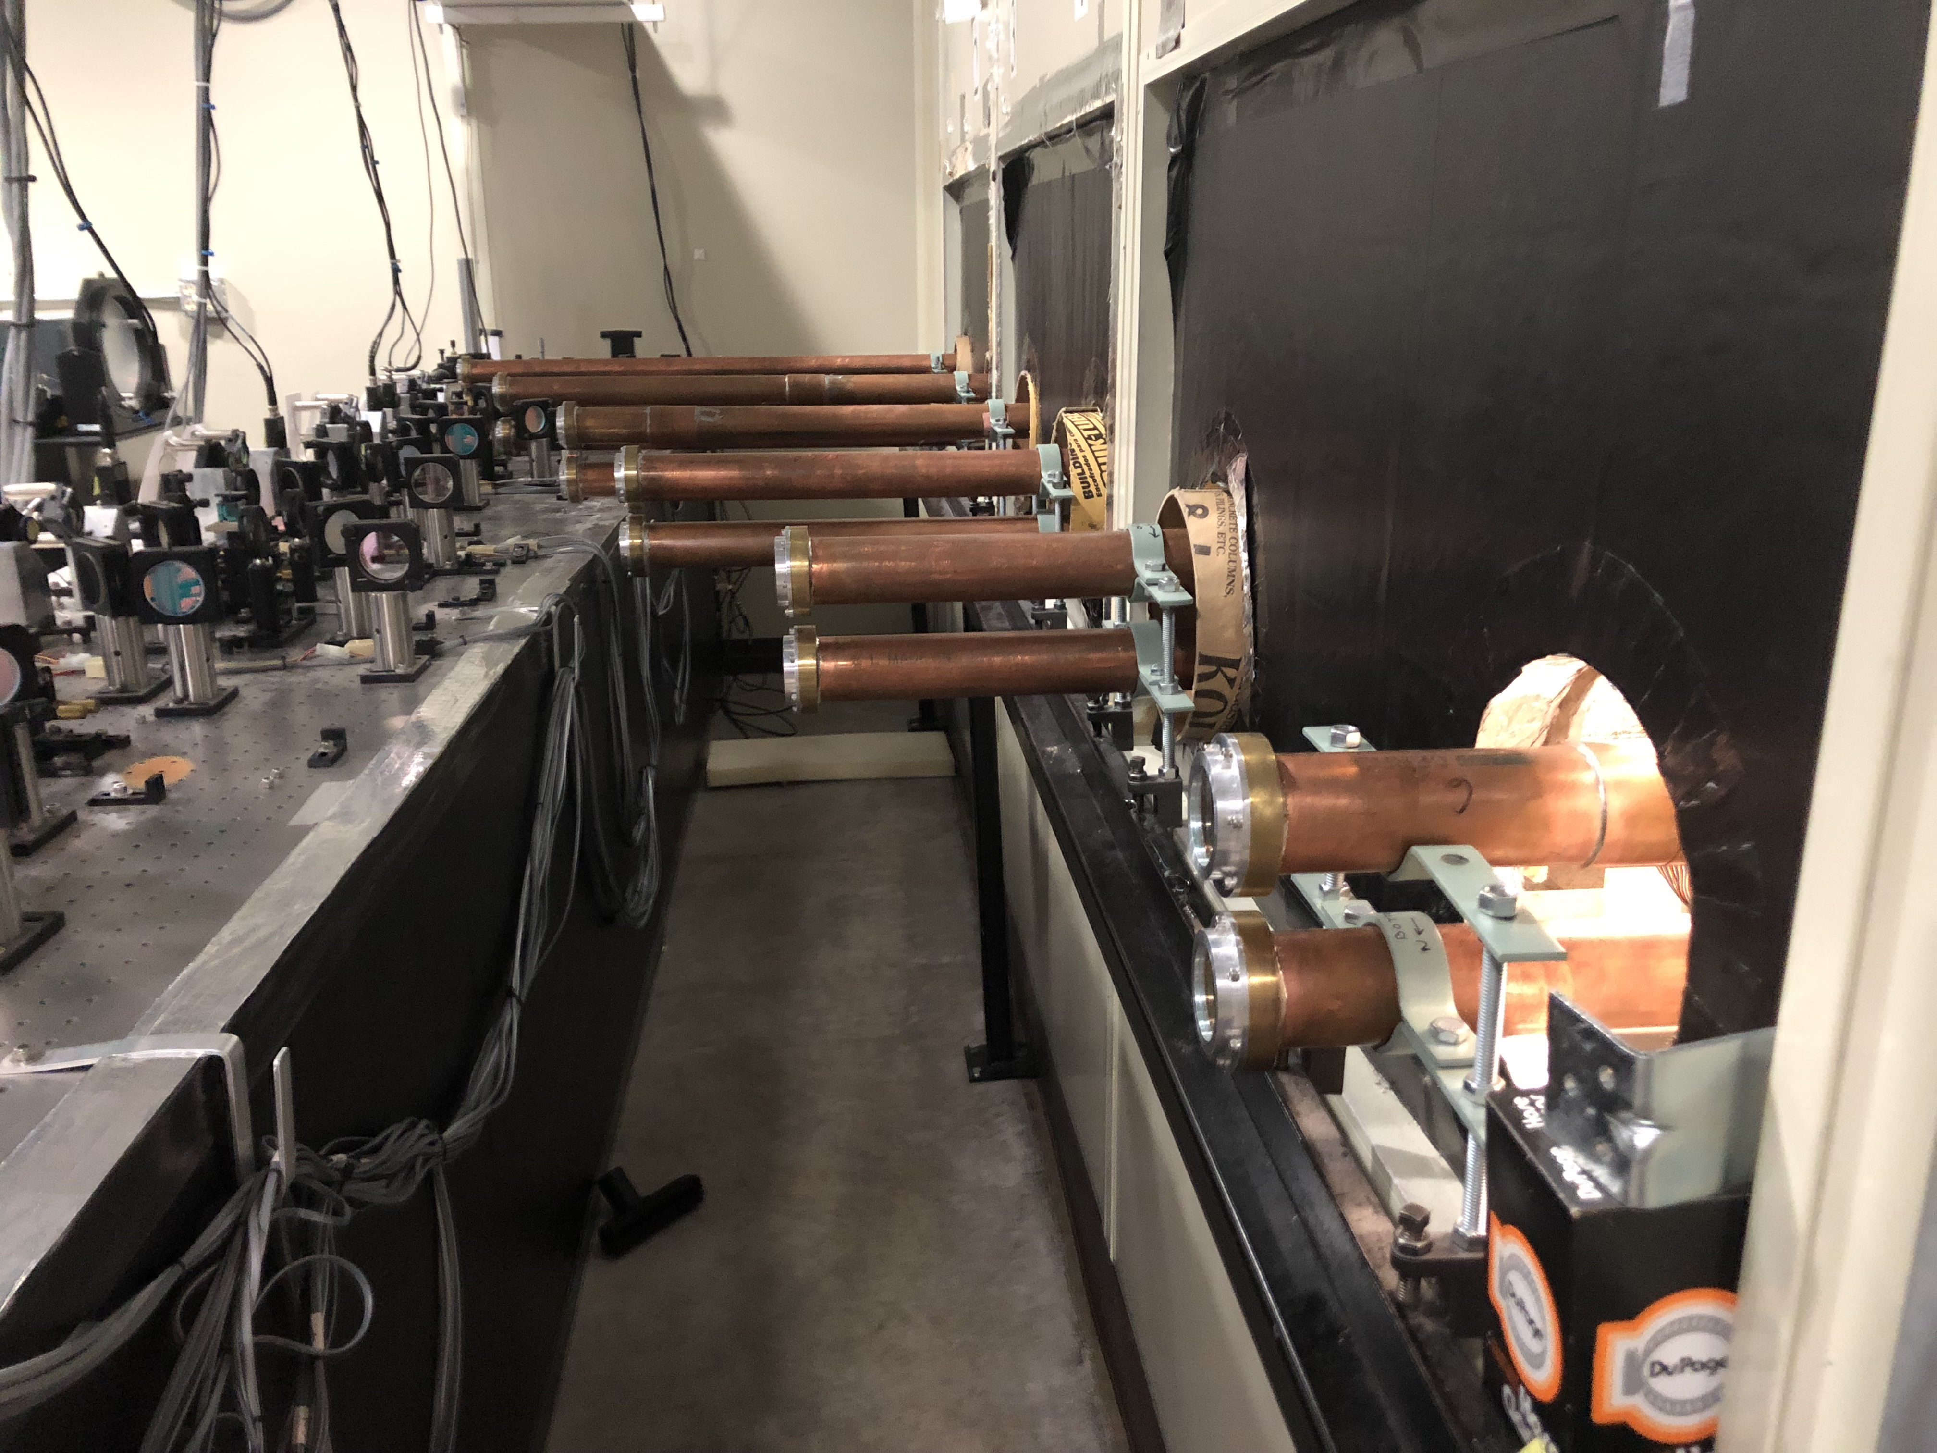
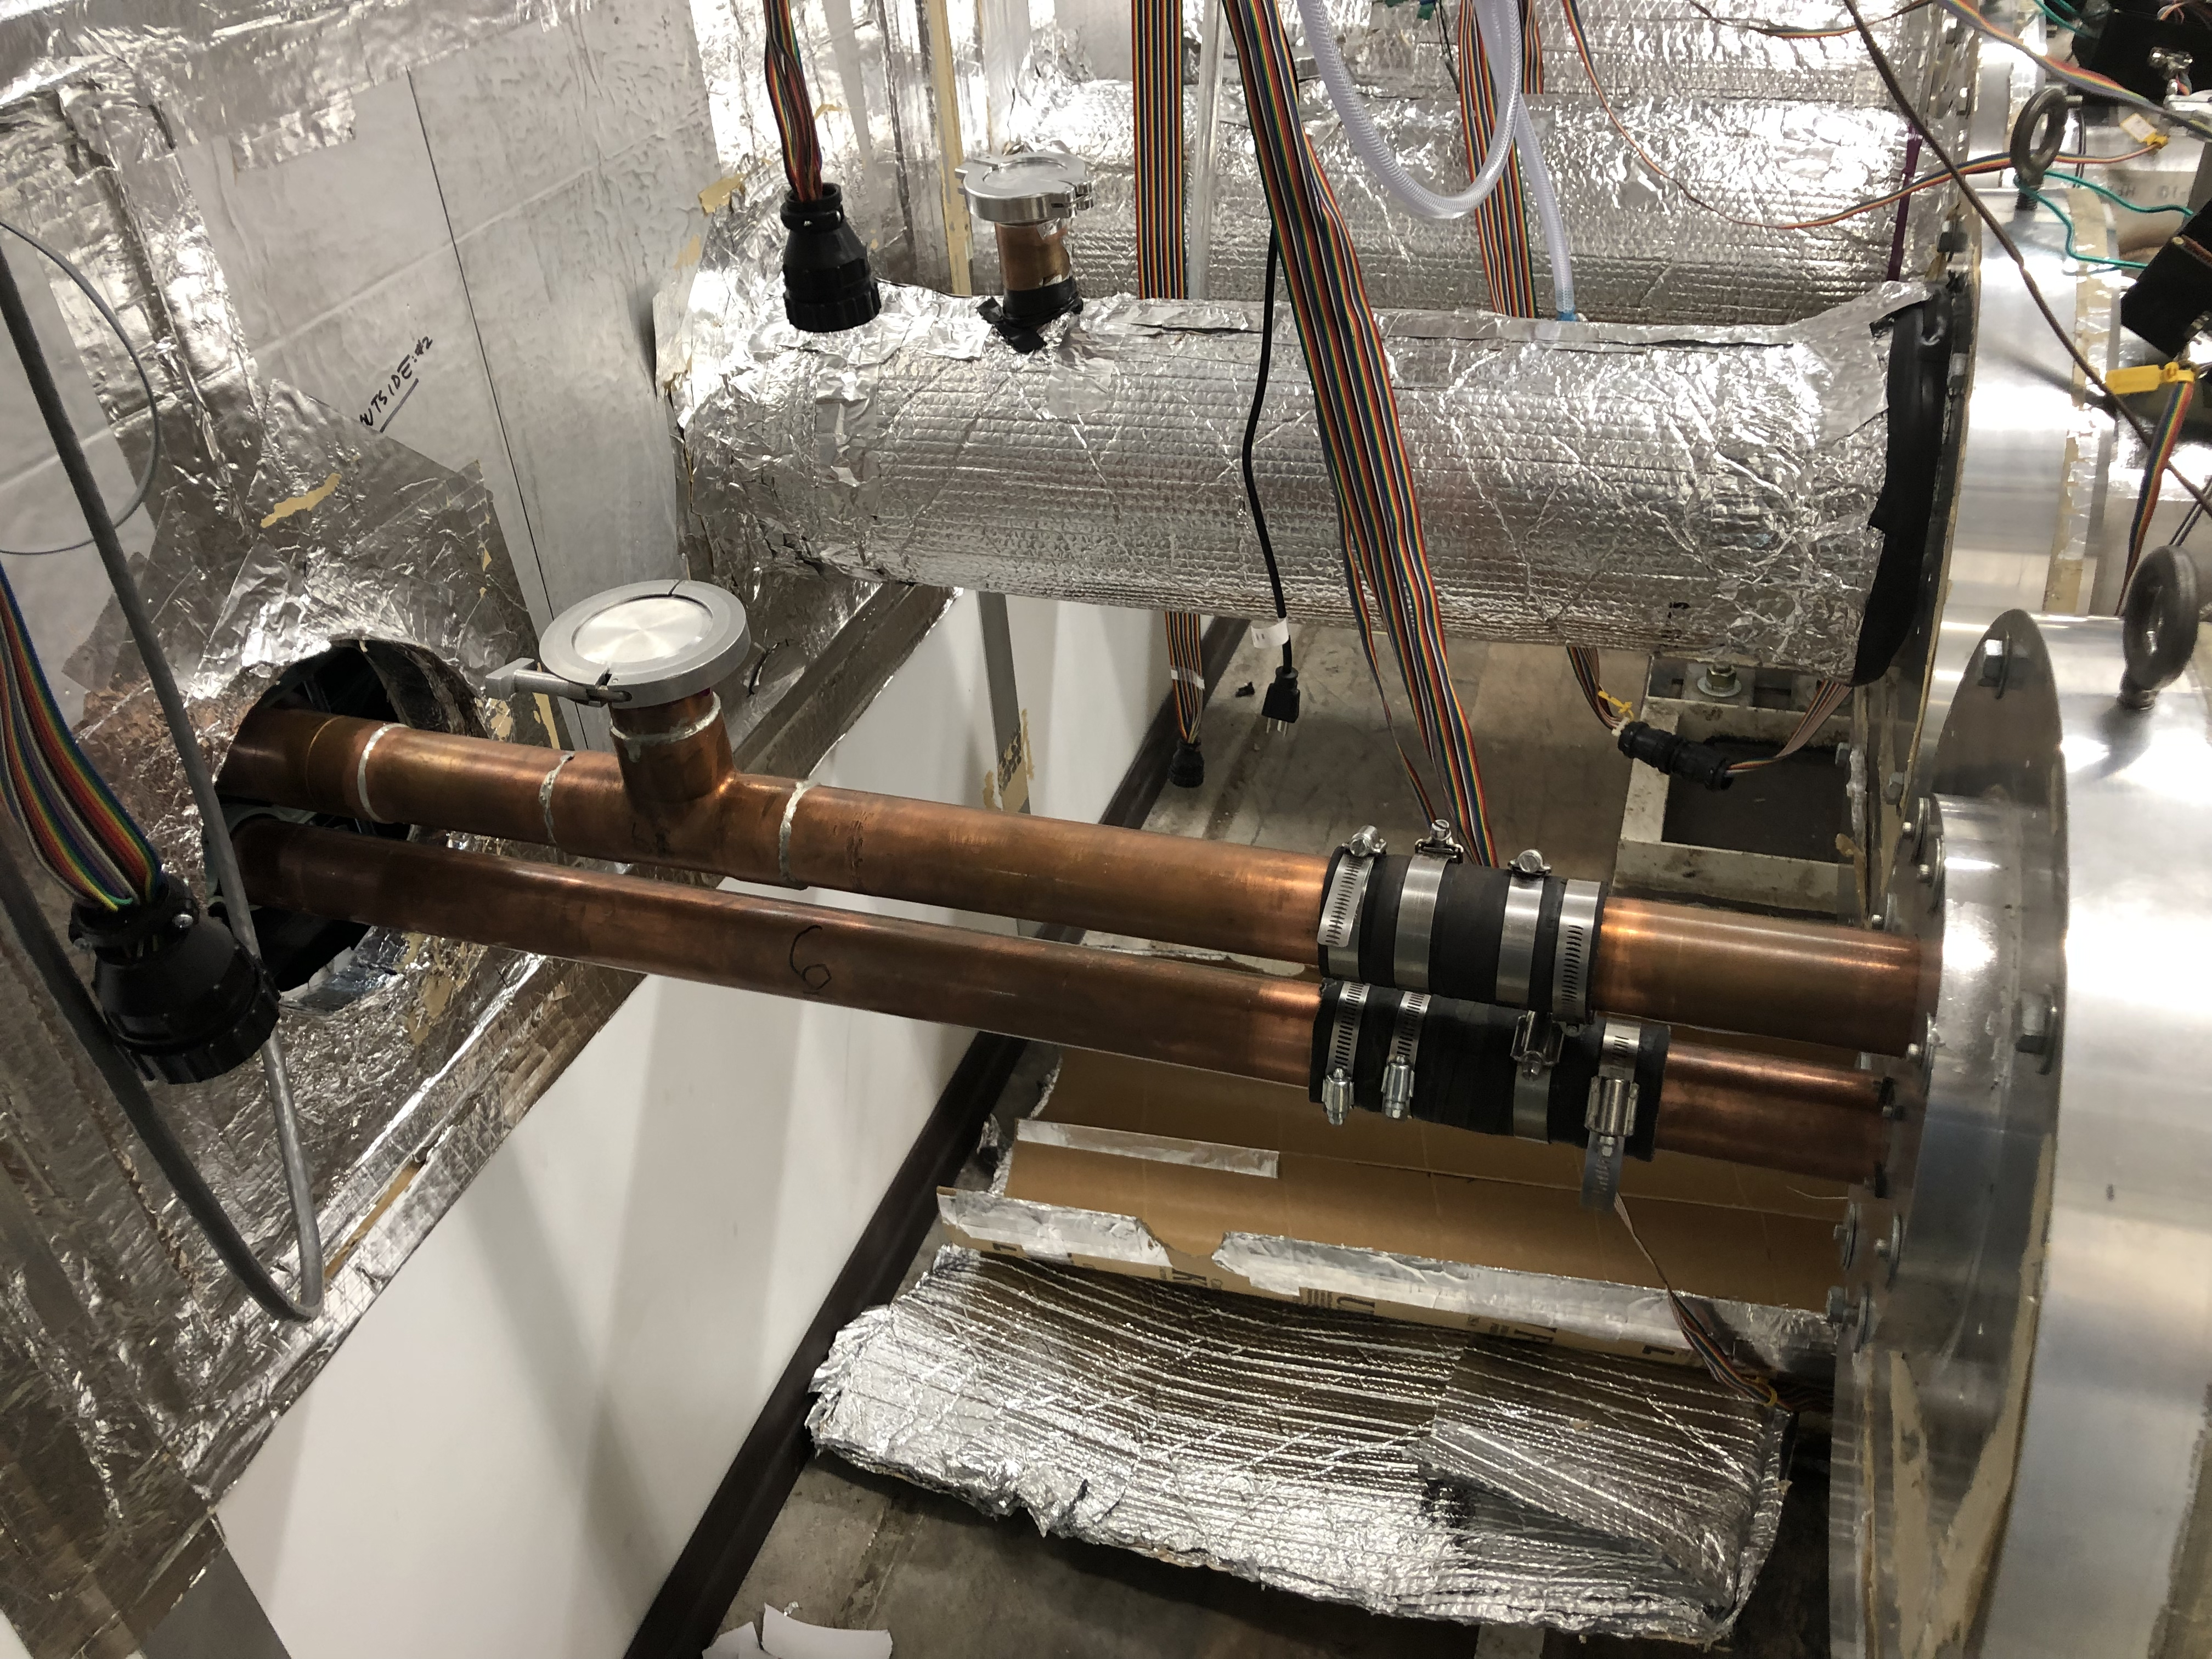
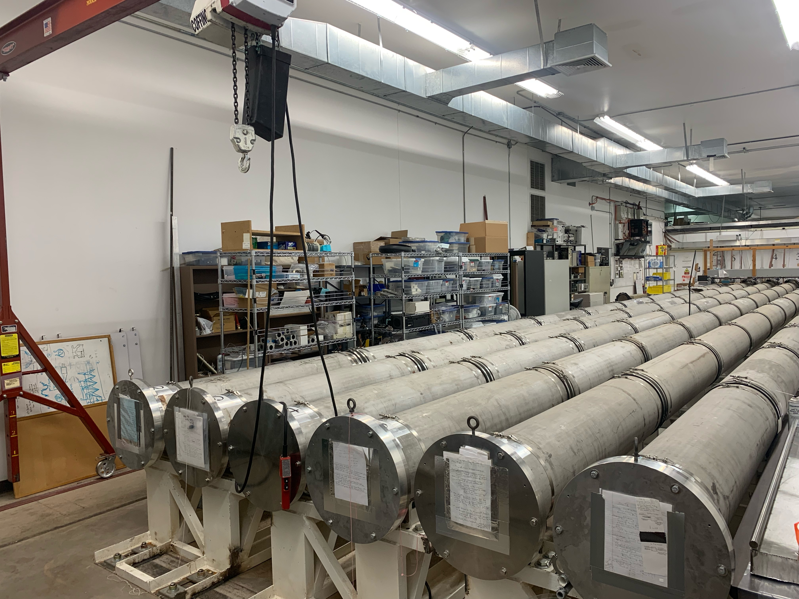
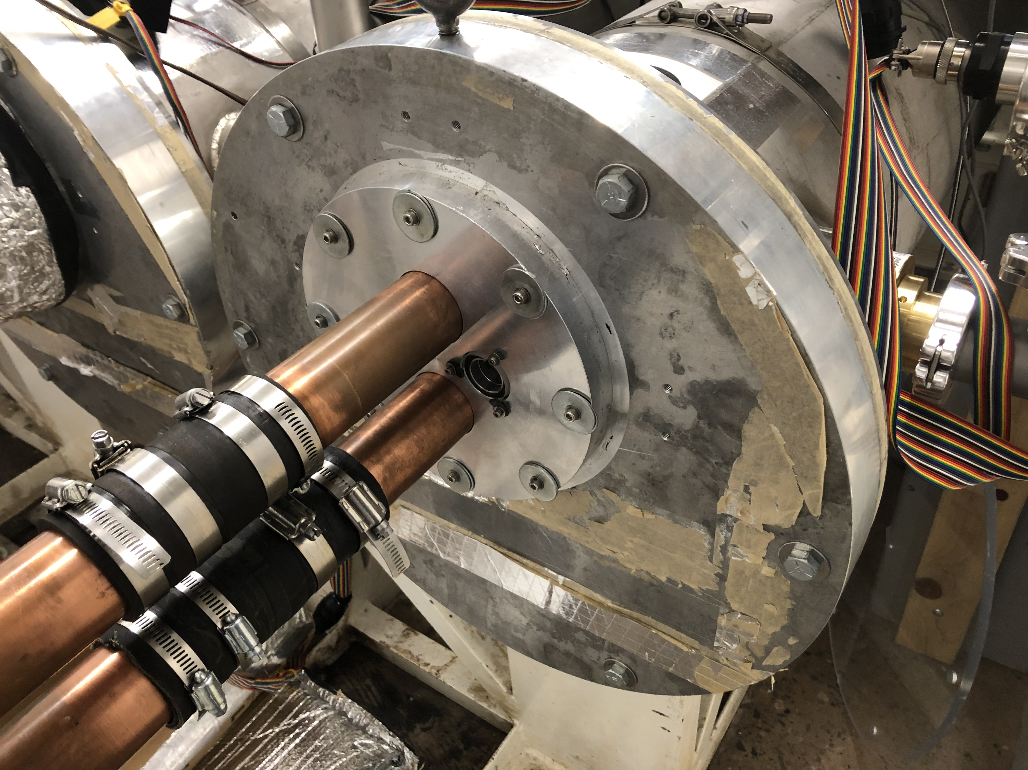
Concept Generation
The main concept of designs was to satisfy the customer's need.
There were three parts that the team needed to design: snoots and front/back seal plates.
Snoot: be able to easily removed. Block any air or light from entering.
Back seal plate: has a window that the client can view inside the vacuum tank.
Front seal plate: weight needs to be less than 35 lbs. Deformation has to be less than 0.01 in
Snoot and front seal plate connected
Back seal plate
Front seal plate

Slide 7
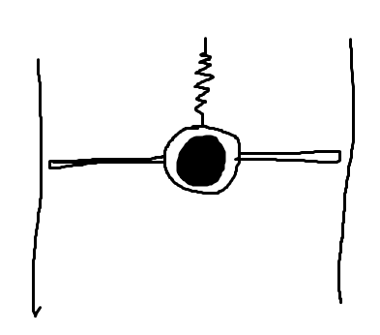
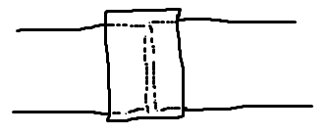
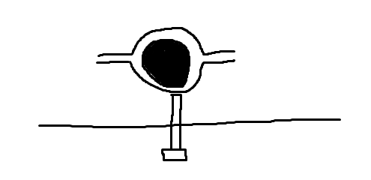
TABLE I: Requirements and Variations
Spring Alignment
Rubber/Hose Sleeve Seal Type
Screw Alignment

Slide 8
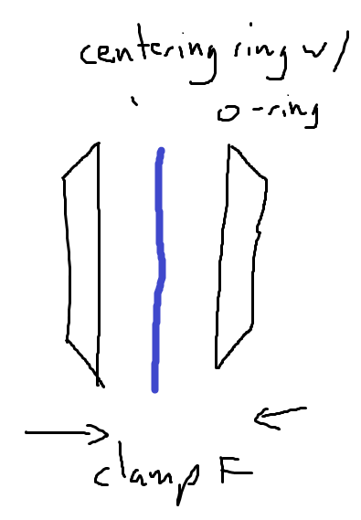
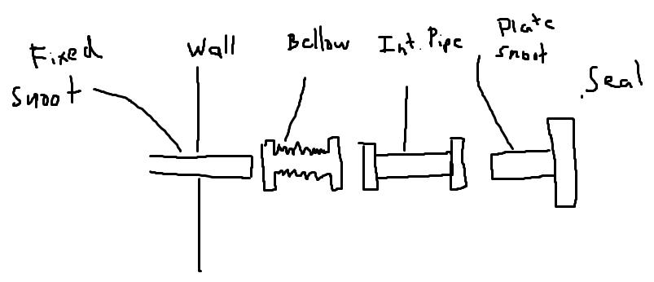
Design Overview
Advantage: can see through inside
Disadvantage: the window need some reinforcement to withstand the vacuum force.
Advantage: the snoot will be divided into 4 parts, which make the dissemble process easier.
Disadvantage: need some lock type of equipment to hold 4 parts together.
Advantage: there will be an O-ring and a lock to tight the part together.
Disadvantage: air may get inside the snoot which will affect the result.

Slide 9
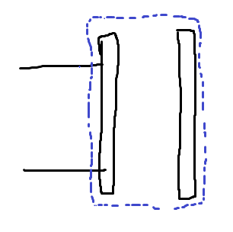
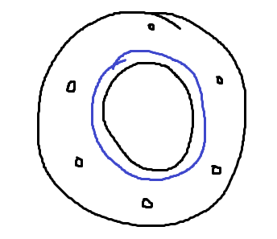
Final Designs (Seal plates)
Design 1: M.R.A.
Magnesium
Rubber Sleeve Seal
Acrylic Sight Ports
Design 2: A.O.P.
Aluminum
O-Ring Seal
Polycarbonate Sight Ports

Slide 10
Final design Evaluation
TABLE II: Final Design Pugh Chart
The A.O.P. design excelled in all aspects

Slide 11
Alignment design evaluation
TABLE III: Alignment Pugh Chart
The Hose-like endings design had the highest score

Slide 12
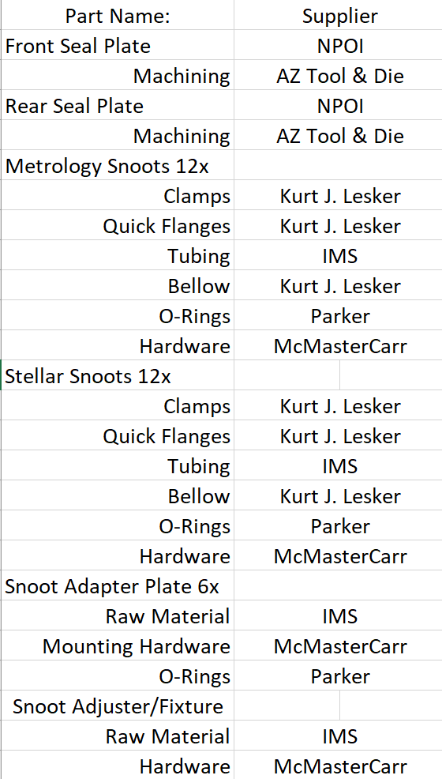
Tentative BOM
TABLE IV: Tentative BOM
12x 22" diameter by 2" thick Plates ordered and arrived at NPOI (Industrial Metal Supply), Previously Ordered
24x Handles have been delivered to NPOI (McMasterCarr), Previously Ordered
Parts ordered goal by: 11-14-2022
Parts Delivered by goal: 11-30-2022
Seal Plates Sent to Machine Shop by: 11-15-2022
Notes:
The tentative BOM shows the current parts used in the capstone and where these parts will be ordered from. Parts ordered is defined per our client to be before 11-14 due to the funding stream. Delivery of parts before 11-30 because there are no lead times currently. The seal plates must be sent out by 11-15 due to the long lead time of machine shops that can support our needs for the seal plate.

Slide 13
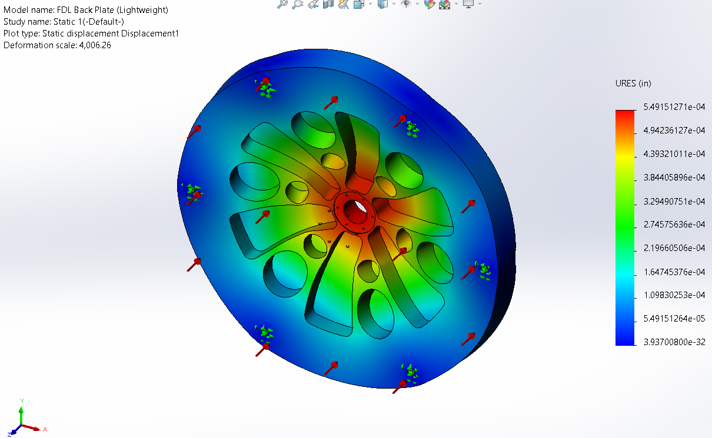
Current CAD models
Back Seal Plate Deformed Under Vacuum (Deflection Shown)
Current Front Seal Plate

Slide 14
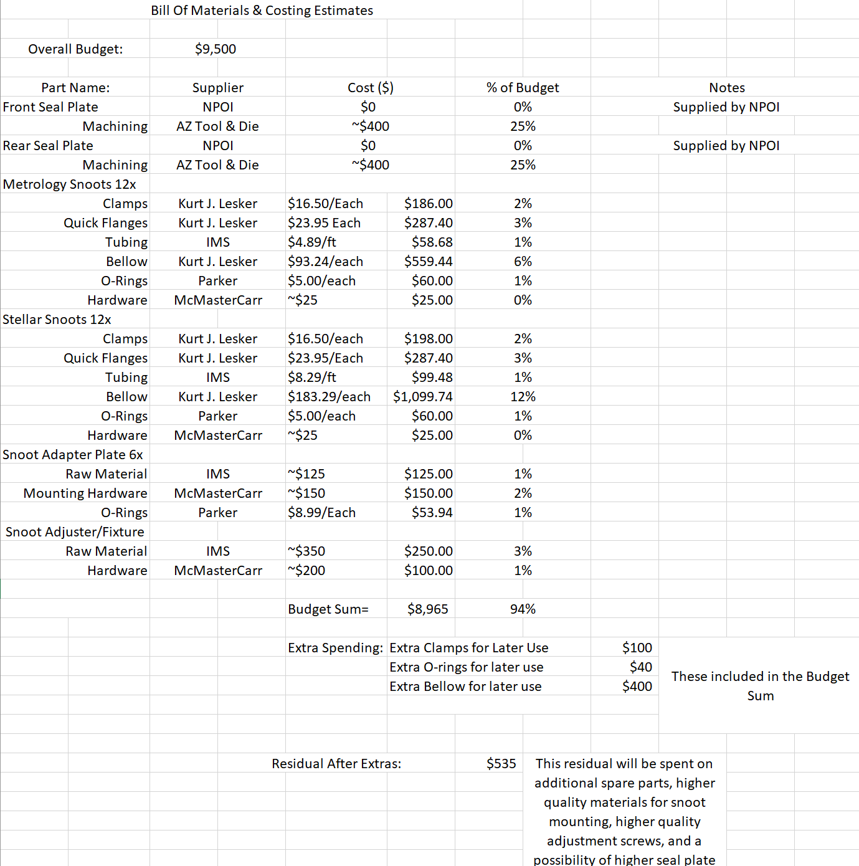
Cost Analysis Update
TABLE V: Tentative Cost Analysis Chart
Notes:
The cost analysis BOM breaks up the project into 6 sections, front seal plate, rear seal plate, metrology snoots, stellar snoots, snoot adapter plate, and snoot adjuster plate. Each Defining the components needed for completion. The bulk cost of our project will be 50% of budget to machine the seal plates to spec. The remaining will be put into smaller parts such as o-rings, clamps, etc can be assembled in house. Small custom parts, with less then quantity 6 will be made in house on NPOI mill/lathe.

Slide 15
Questions?

Slide 16
Refrences
[1] 'The Importance of Choosing the Correct Material for Vacuum O-Rings and Vacuum Seals'. Apple Rubber. [OnlineAccess]. https://www.applerubber.com/hot-topics-for-engineers/the-importance-of-the-correct-material-for-vacuum-o-rings-and-vacuum-seals/
[2] J.A. Clark III , J. Murphy, L. Ha, J. P. Walton , J. Howard, J. T. Armstrong, G. C. Gilbreath , R. B. Hindsley , and T. A. Pauls. 'Alignment of vacuum feed stations on the Navy Prototype Optical Interferometer'. [OnlineAccess]. https://apps.dtic.mil/sti/pdfs/ADA477246.pdf
[3] 'Vacuum Chambers and Optical Equipment'. Imperial Machine & Tool CO. [OnlineAccess]. https://www.imperialmachine.com/vacuum-chambers
[4] 'The long-stroke MROI vacuum delay lines from concept to generation' [OnlineAccess]. https://www.researchgate.net/publication/237371110_The_long-stroke_MROI_vacuum_delay_lines_from_concept_to_production
[5] “Kurt J. Lesker Company,” www.lesker.com. https://www.lesker.com/index.cfm (accessed Oct. 11, 2022).
[6] “Parker Engineering Your Success Motion Control Technology,” Parker Hannifin Corporation, 2020. https://www.parker.com/portal/site/PARKER/menuitem.b90576e27a4d71ae1bfcc510237ad1ca/?vgnextoid=c38888b5bd16e010VgnVCM1000000308a8c0RCRD&vgnextfmt=EN
[7] “Fittings, Flanges, and Hardware | Ideal Vacuum,” www.idealvac.com. https://www.idealvac.com/Fittings-and-Flanges/ct/2 (accessed Oct. 11, 2022).
[8] “Vacuum Fittings and Flanges,” www.newport.com. https://www.newport.com/c/vacuum-flange-components (accessed Oct. 11, 2022).
[9] “Optical Imaging | Laser Optics | Edmund Optics,” www.edmundoptics.com. https://www.edmundoptics.com/
[10] “Carr,” McMaster. [Online]. Available: https://www.mcmaster.com/. [Accessed: 11-Oct-2022].
[11] “Thorlabs, Inc. - your source for fiber optics, laser diodes, optical instrumentation and polarization measurement & control,” Thorlabs, Inc. - Your Source for Fiber Optics, Laser Diodes, Optical Instrumentation and Polarization Measurement & Control. [Online]. Available: https://www.thorlabs.com/. [Accessed: 11-Oct-2022].
[12] “Aluminum supplier,” Aluminum Supplier | Bar, Sheet, Plate, Tube, Pipe, Shape. [Online]. Available: https://www.industrialmetalsupply.com/Products/Metals/aluminum?gclid=EAIaIQobChMIp7f_rKrZgIV9QetBh3t0QAOEAAYASAAEgKFvPD_BwE. [Accessed: 11-Oct-2022].
[13] “Home,” Alaska Rubber Group. [Online]. Available: https://www.alaskarubbergroup.com/. [Accessed: 11-Oct-2022].
[14] Www.htcvacuum.com 日揚科技股份有限公司 |, “Vacuum components suppliers: Vacuum products manufacturer: Vacuum Chamber Kits - HTC Vacuum,” Vacuum Components Suppliers| Vacuum Products Manufacturer | Vacuum Chamber kits - Htc vacuum. [Online]. Available: https://www.htcvacuum.com/en-global/vacuum-components?gclid=EAIaIQobChMIrKbp4arZ-gIV-BetBh3FDAJXEAAYASAAEgKxi_D_BwE. [Accessed: 11-Oct-2022].
[15] “Socket Head Cap Screws Dimensions & Specs | AFT Fasteners,” www.aftfasteners.com. https://www.aftfasteners.com/socket-cap-screws-dimensions-and-mechanical-properties/ (accessed Oct. 11, 2022).

